Slide 1

ENTITY RELATIONSHIP
DIAGRAM

Slide 2
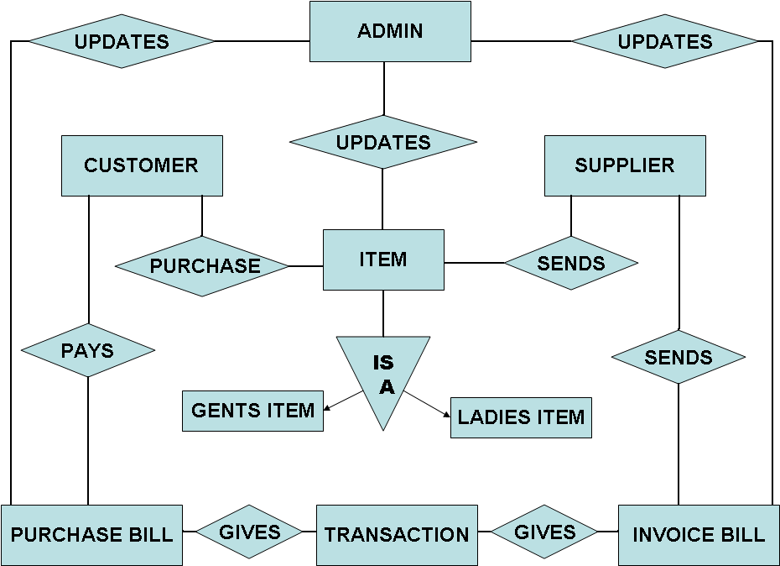
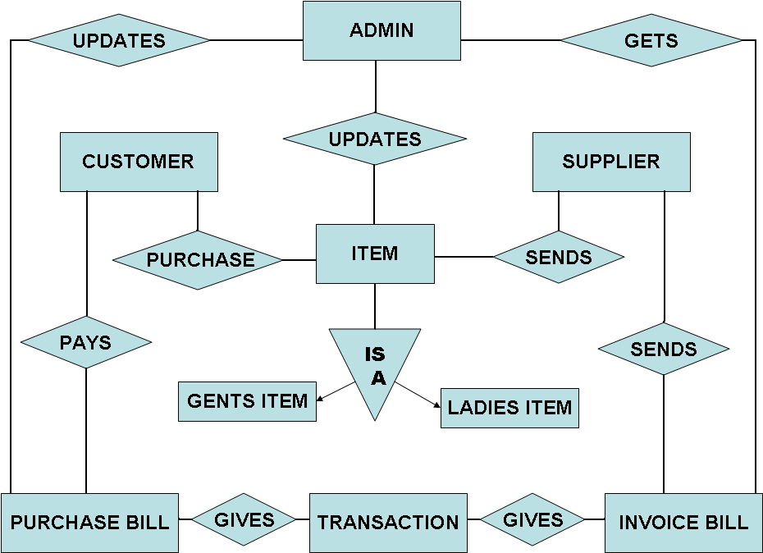

Slide 3
CONTEX LEVEL
DATA FLOW
DIAGRAM

Slide 4
PLACE ORDER
UPDATE CUSTOMR
SUPER
SHOPEE
MANAGMENT
SYSTEM
CUSTOMER
0.0
CUSTOMER
ITEM DETAILS
UPDATE ITEM
ITEM
ITEM
SUPPLIER
SUPPLIER
UPDATE SUPPLIER
SEND ITEMS
TRANSACTION
GENERATES BILL

Slide 5
FIRST LEVEL
DATA FLOW
DIAGRAM

Slide 6
CUSTOMER
PROCESS
CUSTOMER
DETAILS
1.0
CUSTOMER
CUSTOMER
ITEM DETAILS
ITEM
PROCESS
2.0
ITEM
ITEM

Slide 7
SUPPLIER DETAILS
SUPPLIER
PROCESS
3.0
SUPPLIER
SUPPLIER
UPDATE
TRANSACTION
PURCHASE
ORDER
PROCESS
4.0
SUPPLIER
TRANSACTION
INVOICE BILL
GENERATES

Slide 8
UPDATE
TRANSACTION
SALES
ORDER
PROCESS
5.0
CUSTOM
TRANSACTION
PURCHASE BILL
GENERATES
REPORT
GENERATION
CUSTOMER
6.0
SUPPLIER
REPORT
ITEM
SALES TRANSACTION
PURCHASE TRANSACTION

